Slide 1
Computer Modelling and Simulation
Lecture 2

Slide 2

What is this?
This is not an apple.
It’s a representation of an apple
Sufficient for those who want to know what an apple looks like but not for those who want to know how it tastes like

Slide 3
What is a model?
A model is an abstract representation of a system.
An abstraction in which only the essential ingredients are retained according to the questions we ask about the system.
Level of details?
“Everything should be made as simple as possible but not simpler.” Albert Einstein.
The same system can be described at different scales.
Cells, tissues, organs, living beings
Mechanical parts, cars, traffic

Slide 4
System
The term "system" comes from the Latin word systēma, "whole concept made of several parts or members”
An entity or group of entities that exist and operate in time and space.
International Council of Systems Engineering INCOSE suggests that a system is a construct or collection of different elements that together produces results not obtainable by the elements alone.
System refers to the subject of model development; that is, it is the subject or thing that will be investigated or studied using M & S.

Slide 5
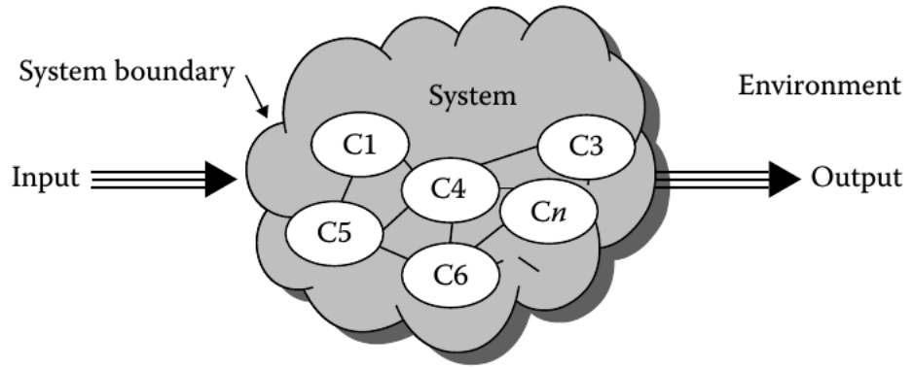
System

Slide 6
System
Examples
Planetary system in the universe (gravitation bound objects in orbit around a star)
Banking system in finance industry (payment, loan, deposit, investment processes)
Software system in a computer (processes, threads, IPC, etc.)
Other examples are in medicine, biology, socio-economic, political, communications, environment, transportation, electrical, mechanical, etc

Slide 7
Types of Models
Physical
Notional

Slide 8
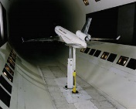

Types of Models
A model can be physical , such as a scale model of an airplane to study aerodynamic behavior.

Slide 9
Types of Models
A model can be notional i.e. a model consists of a set of mathematical equations or logic statements that describes the behavior of the system.
Mathematical model
Simple equations often result in analytic solutions that has mathematical proofs.
Some mathematical models require numerical solutions
Logical model
Software analysis/design models, computer programs.

Slide 10
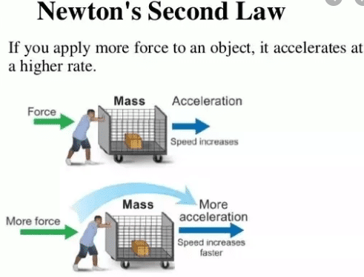
Example of Mathematical model
F = ma

Slide 11
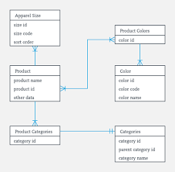
Example of a Logical model
An example Class Diagram

Slide 12
Another definition of Simulation
Sometimes the mathematical model is sufficiently complex that the only way to solve the equations is numerically. This process is referred to as computer simulation .
Essentially, a system is modeled using mathematical equations; then, these equations are solved numerically using a digital computer to indicate likely system behavior.
Analytic solutions are precise mathematical proofs, and as such, they cannot be conducted for all classes of models.
The alternative is to solve numerically with the understanding that an amount of error may be present in the numerical solution.

Slide 13
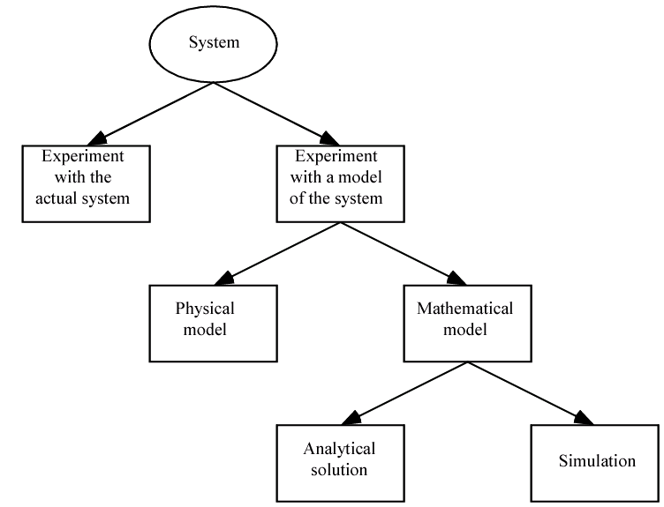
Another definition of Simulation

Slide 14
Types of Simulation
Live Simulation
Virtual Simulation
Constructive simulation

Slide 15
Types of Simulation
A live simulation involves real people operating real systems.
Example: War games
The purpose of live simulation training is to provide a meaningful and useful experience for the trainee.

Slide 16
Types of Simulation
A virtual simulation is different from live simulation in that it involves real people operating in simulated systems.
These systems are recreated with simulators, and they are designed to immerse the user in a realistic environment.
Example: Cockpit simulator

Slide 17
Types of Simulation
Constructive simulation
This simulation involves real people making inputs into a simulation that carry out those inputs by simulated people operating in simulated systems.
The expected result of constructive simulation is that it will provide a useful result.
Example: SimCity

Slide 18
Advantages of M&S
The ability to choose correctly by testing every aspect of a proposed change without committing additional resources.
Compress and expand time to allow the user to speed up or slow - down behavior or phenomena to facilitate in - depth research
Understand why by reconstructing the scenario and examining the scenario closely by controlling the system
Explore possibilities in the context of policies, operating procedures, methods without disrupting the actual or real system
Diagnose problems by understanding the interaction among variables that make up complex systems
Develop understanding by observing how a system operates rather than predictions about how it will operate
Visualize the plan with the use of animation to observe the system or organization actually operating
Better training can be done less expensively and with less disruption than on - the - job training

Slide 19
Disadvantages of M & S
Simulation results may be difficult to interpret
Some simulations may take months to complete
Some simulations may require expensive hardware
Some simulations may be run when they are not needed. For example,when analytical solutions are available.

Slide 20
Types of Modelling Techniques
Physics-based
Data-based
Agent-based
Cellular Automata

Slide 21
Physics-based Modelling
Solidly grounded in Mathematics.
A physics - based model is a mathematical model where the model equations are derived from basic physical principles.
Example:
The height of a body falling freely under gravity is modelled by
h = v_{i}t+1/2gt²
Predator-Prey relationship is modelled by
ds/dt = k_{s}s – k_{hs}h_{s}
dh/dt = k_{sh}s_{h} – k_{h}h

Slide 22
Data-based (Data-Driven) Modelling
Results from models based on data describing represented aspects of the subject of the model.
Model development begins with data collection, which is used in simulations.
When the physics of the model subject is not understood or computations costs are high, data - based modelling can substitute.
This modeling relies on data availability — it functions at its best when the data are accurate and reliable.

Slide 23
Data-based (Data-Driven) Modelling
We have data measurements and wish to obtain a function that roughly goes through a plot of the data points capturing the trend of the data, or fitting the data.
Then we can use the function to find estimates at places where data do not exist or to perform further computations.
This function is called Empirical Model.
An empirical model is based only on data and is used to predict, not explain, a system.

Slide 24
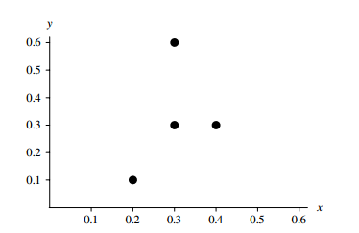
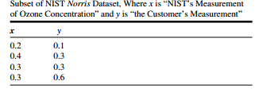
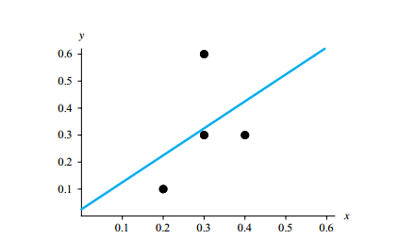
Example of Data-Driven Modelling
Plot of given data
Plot of given data with best-fit line

Slide 25
Agent-based Modelling
ABMs consist of agents.
Agents are defined as “autonomous software entities that interact with their environment or other agents to achieve some goal or accomplish some task. “
An agent’s environment and the existence of other agents in that environment also play a key role on how an agent may behave.
Example: If the Predator-Prey relationship is modeled using Agent-based modelling then the Predator and Prey will be both modelled as agents each with their own set of states which they change based on their interaction with each other and their environment.

Slide 26
Agent-based Modelling
Each agent has a state, which is represented by a set of state variables and behaviors, which control its actions.
A method or procedure, which is associated with a class, or breed or group, of agents, is a function that captures some or all of an agent’s behavior.
A simulation frequently includes several global simulation variables, which all agents can access.

Slide 27
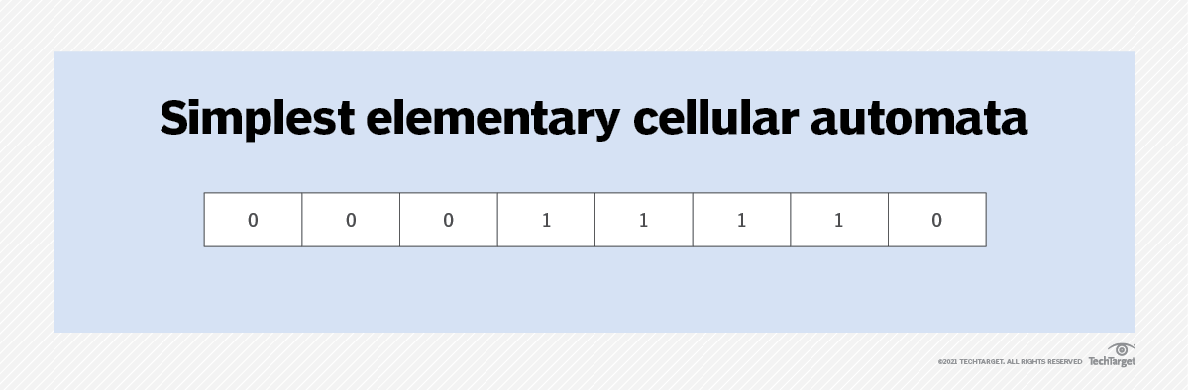
Cellular Automata
A discrete model of computation
Cellular automata have found application in various areas, including physics, theoretical biology and microstructure modeling.
A cellular automaton consists of a regular grid of cells, each in one of a finite number of states, such as on and off

Slide 28
Paradigms of Simulation
Continuous Simulation
Discrete-Event Simulation
Monte Carlo Simulation

Slide 29
Continuous Simulation
The system variables are continuous functions of time .
Time is the independent variable and the system variables evolve as time progresses.
Continuous simulations systems make use of differential equations in developing the model

Slide 30

Continuous Simulation
Example: Consider bacterial population of size 100, an instantaneous growth rate of 10% = 0.10, and time measured in hours. Then, the population growth can be modeled using the following equation:

Slide 31
Discrete-Event Simulation
The system variables are discrete functions in time.
These discrete functions in time result in system variables that change only at distinct instants of time.
The changes are associated with an occurence of a system event.
Discrete - event simulations advance time from one event to the next event.
This simulation paradigm adheres to queuing theory models.

Slide 32
Discrete-Event Simulation
Take the example of traffic light.
State: Its state can be represented by which light is activated at any given time. So State variable called light color is chosen to represent its state.
The value of that variable at any given point in time completely describes the state of the traffic light.
Events for the traffic light system consist of switch to red, switch to yellow , and switch to green .
These events occur in a predetermined sequence and may be triggered by the passage of a certain amount of time. Or they may be triggered by the event of the presence of a vehicle over some roadway sensor or a video system recognizing when a vehicle enters its field of view.

Slide 33
Monte Carlo Simulation
Randomly samples values from each input variable distribution and uses that sample to calculate the model ’ s output.
This process of random sampling is repeated until there is a sense of how the output varies given the random input values.
Monte Carlo simulation models system behavior using probabilities.

Slide 34
Example of Monte Carlo Simulation
Consider you have a coin which you toss four times and you want to find the probability of having 3 heads and 1 tail.
Using combinatorics, we’ll find the probability in the following way
P(3 heads and 1 tail) = 4/16 = 1/4
There are 4 possibilities that tail would occur exactly once so remaining three times heads would occur and the total number of possible combinations of heads and tails in 4 tosses would be 2⁴=16.
But not in every situation you can use the concept of combinatorics to find the probability of an event.

Slide 35
Example of Monte Carlo Simulation
The probability of 3 heads and 1 tail in 4 tosses of the coin can be found by the Monte Carlo simulation in the following way:
Toss the coin 4 times and see if the desired outcome (3 heads and 1 tail) has occurred or not.
Tossing 4 coins once constitute one experiment.
Repeat this experiment a larger number of times.
Count the number of times the desired outcome has occurred.
Divide the count in the above step by total number of experiments.
The result will be the probability of getting three heads and 1 tail in 4 tosses of coin using Monte Carlo simulation.

